Slide 1
Four Paths to Data Science Success Using Microsoft Azure
February 5th, 2019
Brad Llewellyn
Data Analytics Architect
Microsoft

Slide 2
The views expressed during this presentation may not represent the official views of Microsoft or the FastTrack for Azure team.

Slide 3





MCSE: Data Management and Analytics
MCSE: Cloud Platform and Infrastructure
MCSA: Machine Learning
MCSA: SQL 2016 BI Development
MCA: SQL 2016 Database Development
MCSA: SQL Server 2012/2014
MCSA: Cloud Platform
M.S. Statistics: University of South Carolina
Analytics Consultant – 6 Years
Microsoft – 1 Month
@BreakingBI
https://www.linkedin.com/in/bradllewellyn
http://breaking-bi.blogspot.com
Llewellyn.wb@gmail.com
Brad Llewellyn
Data Analytics Architect
Microsoft
Organizer – Charlotte BI Group – http://charbigroup.com
Member and Speaker – PASS – http://www.pass.org

Slide 4



https://www.pass.org

Slide 5
What’s the “Best” Way to Solve the Business Problem?

Slide 6
Customer’s Primary Concerns
Will it solve my problem?
How much will it cost to implement?
How long will it take to implement?
How much will it cost to maintain it?
How quickly does it adapt to changing requirements?

Slide 7




Agenda
Power BI
Cognitive Services
Azure Machine Learning Studio
R, Python and Hadoop

Slide 8
Contoso Beverage Company
Contoso Beverage Company (CBC) is a large beverage distribution company in the United States.
Their main source of revenue is selling cases of soda, tea and other beverages to customers all over the world.
Customers can place orders using CBC’s intuitive website.
CBC also sells and services fountain beverage machines.
However, this is a separate branch of the business that only takes orders over the phone.

Slide 9
Power BI
Introduction to Analytics

Slide 10
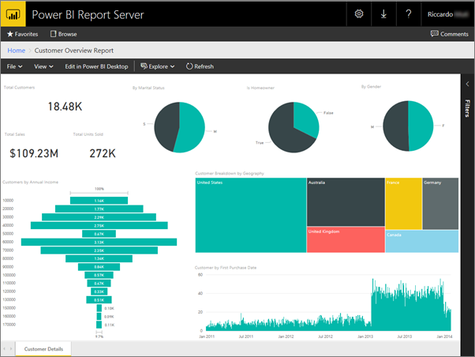
What is Power BI?
Data Analytics
Reporting
Self-Service BI
Cloud or On-Prem

Slide 11
Business Problem
CBC offers a lifetime warranty on all the fountain beverage machines they sell.
The Engineering Team wants to perform “Data Science” on their data in order to find out which types of machines they should be selling and who they should be selling to in order to reduce their repair costs in the future.
This data is currently stored in multiple Excel files on the Manager’s laptop.

Slide 12
Does this Solve the Business Problem?

Slide 13
Business Problem
CBC offers a lifetime warranty on all the fountain beverage machines they sell.
The Engineering Team wants to perform “Data Science” on their data in order to find out which types of machines they should be selling and who they should be selling to in order to reduce their repair costs in the future.
This data is currently stored in multiple Excel files on the Manager’s laptop.

Slide 14
Business Problem
CBC offers a lifetime warranty on all the fountain beverage machines they sell.
The Engineering Team wants to perform “Data Science” on their data in order to find out which types of machines they should be selling and who they should be selling to in order to reduce their repair costs in the future.
This data is currently stored in multiple Excel files on the Manager’s laptop.

Slide 15
Business Problem
CBC offers a lifetime warranty on all the fountain beverage machines they sell.
The Engineering Team wants to perform “Data Science” on their data in order to find out which types of machines they should be selling and who they should be selling to in order to reduce their repair costs in the future.
This data is currently stored in multiple Excel files on the Manager’s laptop.

Slide 16
Business Problem
CBC offers a lifetime warranty on all the fountain beverage machines they sell.
The Engineering Team wants to perform “Data Science” on their data in order to find out which types of machines they should be selling and who they should be selling to in order to reduce their repair costs in the future.
This data is currently stored in multiple Excel files on the Manager’s laptop.

Slide 17
Business Problem
CBC offers a lifetime warranty on all the fountain beverage machines they sell.
The Engineering Team wants to perform “Data Science” on their data in order to find out which types of machines they should be selling and who they should be selling to in order to reduce their repair costs in the future.
This data is currently stored in multiple Excel files on the Manager’s laptop.

Slide 18
Why Power BI?
which types of machines they should be selling
who they should be selling to
reduce their repair costs
Self-Service Reporting and Analysis Capabilities
multiple Excel files on the Manager’s laptop
Can Easily Ingest Data from Most Sources
Can be Developed by Power Users and Business Experts
Quick Implementation Timeframe
Low Cost of Ownership
As Needs Grow, Skillset is Widely Available in the Market
Ability to Utilize R and Python in Advanced Use Cases

Slide 19
Cognitive Services
Less Artificial, More Intelligence

Slide 20
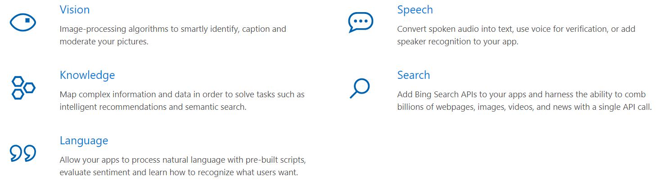
What is Cognitive Services?
Collection of Pre-Built Machine Learning and Artificial Intelligence Algorithms in Azure
Trained Using Microsoft Data (Bing, Cortana, etc.)

Slide 21
Business Problem
CBC’s website allows customers to leave comments about their orders.
The Customer Service team wants to perform “Data Science” on their data to find out which types of customers and/or orders tend to leave negative feedback.
This data is currently stored in a SQL Server table.

Slide 22
Does this Solve the Business Problem?

Slide 23
Business Problem
CBC’s website allows customers to leave comments about their orders.
The Customer Service team wants to perform “Data Science” on their data to find out which types of customers and/or orders tend to leave negative feedback.
This data is currently stored in a SQL Server table.

Slide 24
Business Problem
CBC’s website allows customers to leave comments about their orders.
The Customer Service team wants to perform “Data Science” on their data to find out which types of customers and/or orders tend to leave negative feedback.
This data is currently stored in a SQL Server table.

Slide 25
Business Problem
CBC’s website allows customers to leave comments about their orders.
The Customer Service team wants to perform “Data Science” on their data to find out which types of customers and/or orders tend to leave negative feedback.
This data is currently stored in a SQL Server table.

Slide 26
Business Problem
CBC’s website allows customers to leave comments about their orders.
The Customer Service team wants to perform “Data Science” on their data to find out which types of customers and/or orders tend to leave negative feedback.
This data is currently stored in a SQL Server table.

Slide 27
Business Problem
CBC’s website allows customers to leave comments about their orders.
The Customer Service team wants to perform “Data Science” on their data to find out which types of customers and/or orders tend to leave negative feedback.
This data is currently stored in a SQL Server table.

Slide 28
Why Cognitive Services?
website
SQL Server table
Easily Accessible as Azure APIs
find out which types of customers and/or orders
negative feedback
Pre-Built Algorithms Do Not Require Data or Training
Quick Implementation Timeframe
Low Cost of Ownership
As Needs Grow, Skillset is Widely Available in the Market

Slide 29
Azure Machine Learning Studio
Data Science Made Easy

Slide 30
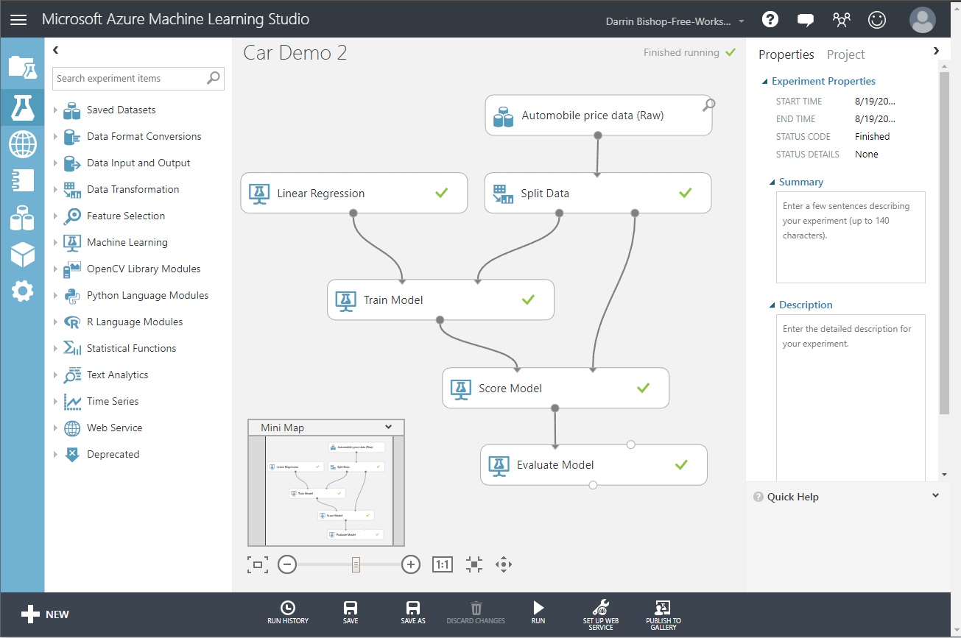
What is Azure Machine Learning Studio?
Machine Learning
Drag-and-Drop Interface
Entirely Cloud SaaS
Minimal Data Science Experience Required

Slide 31
Business Problem
CBC’s customer churn rate has been steady for the past three years.
The Account Management Team can see this information using their existing set of reports and dashboards in Power BI.
They want to perform “Data Science” to predict when customers are likely to churn.
They will use this information to reach out to these customers and attempt remediation.
This data is currently stored in a SQL Server Data Mart.

Slide 32
Does this Solve the Business Problem?

Slide 33
Business Problem
CBC’s customer churn rate has been steady for the past three years.
The Account Management Team can see this information using their existing set of reports and dashboards in Power BI.
They want to perform “Data Science” to predict when customers are likely to churn.
They will use this information to reach out to these customers and attempt remediation.
This data is currently stored in a SQL Server Data Mart.

Slide 34
Business Problem
CBC’s customer churn rate has been steady for the past three years.
The Account Management Team can see this information using their existing set of reports and dashboards in Power BI.
They want to perform “Data Science” to predict when customers are likely to churn.
They will use this information to reach out to these customers and attempt remediation.
This data is currently stored in a SQL Server Data Mart.

Slide 35
Business Problem
CBC’s customer churn rate has been steady for the past three years.
The Account Management Team can see this information using their existing set of reports and dashboards in Power BI.
They want to perform “Data Science” to predict when customers are likely to churn.
They will use this information to reach out to these customers and attempt remediation.
This data is currently stored in a SQL Server Data Mart.

Slide 36
Business Problem
CBC’s customer churn rate has been steady for the past three years.
The Account Management Team can see this information using their existing set of reports and dashboards in Power BI.
They want to perform “Data Science” to predict when customers are likely to churn.
They will use this information to reach out to these customers and attempt remediation.
This data is currently stored in a SQL Server Data Mart.

Slide 37
Business Problem
CBC’s customer churn rate has been steady for the past three years.
The Account Management Team can see this information using their existing set of reports and dashboards in Power BI.
They want to perform “Data Science” to predict when customers are likely to churn.
They will use this information to reach out to these customers and attempt remediation.
This data is currently stored in a SQL Server Data Mart.

Slide 38
Why Azure Machine Learning Studio?
existing set of reports and dashboards in Power BI
SQL Server Data Mart
Accessible to Data Professionals with Minimal Machine Learning Experience
Supports Limited Use of SQL, R and Python
Easily Deploy and Access Experiments using Azure APIs
predict when customers are likely to churn.
reach out to these customers and attempt remediation
Capable of Creating Targeted Machine Learning Models
Quick Implementation Timeframe
Low Cost of Ownership

Slide 39
R, Python and Hadoop
Bringing Out the Big Guns

Slide 40

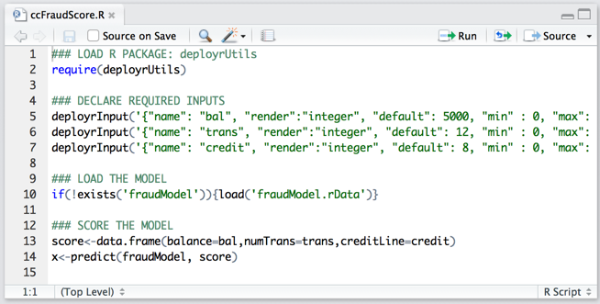
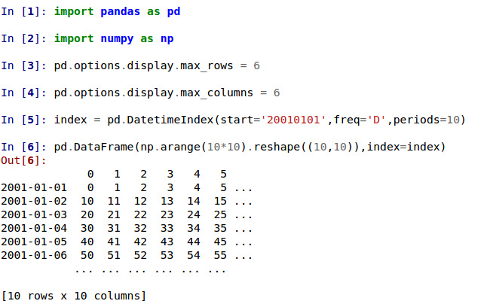

What are R and Python?
Common Data Science Programming Languages
Azure Options
SQL Server
SQL Database
Notebooks
Data Science Virtual Machine
Machine Learning Services
Data Lake Analytics
Databricks
HDInsight

Slide 41
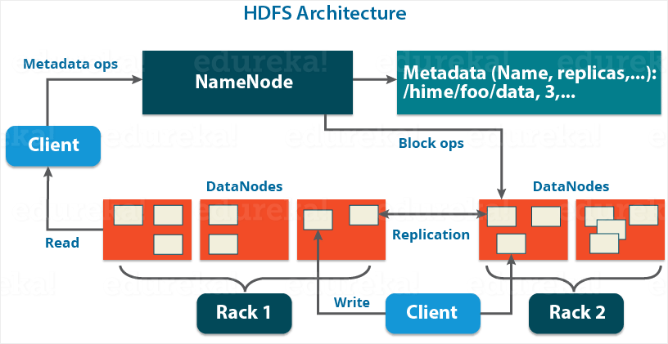



What is Hadoop?
Industry-Standard Open-Source Big Data Ecosystem
Expertise is Rare and Expensive
Azure Options
HDInsight – IaaS/PaaS
Databricks – PaaS/SaaS

Slide 42
Business Problem
CBC’s online sales system contains 10,000 different products and processes over 1,000,000 orders per day.
The Marketing Team would like to perform “Data Science” to recommend additional products to their customers while they use the online system.
This data is stored in Azure Blob Storage.

Slide 43
Does this Solve the Business Problem?

Slide 44
Business Problem
CBC’s online sales system contains 10,000 different products and processes over 1,000,000 orders per day.
The Marketing Team would like to perform “Data Science” to recommend additional products to their customers while they use the online system.
This data is stored in Azure Blob Storage.

Slide 45
Business Problem
CBC’s online sales system contains 10,000 different products and processes over 1,000,000 orders per day.
The Marketing Team would like to perform “Data Science” to recommend additional products to their customers while they use the online system.
This data is stored in Azure Blob Storage.

Slide 46
Business Problem
CBC’s online sales system contains 10,000 different products and processes over 1,000,000 orders per day.
The Marketing Team would like to perform “Data Science” to recommend additional products to their customers while they use the online system.
This data is stored in Azure Blob Storage.

Slide 47
Business Problem
CBC’s online sales system contains 10,000 different products and processes over 1,000,000 orders per day.
The Marketing Team would like to perform “Data Science” to recommend additional products to their customers while they use the online system.
This data is stored in Azure Blob Storage.

Slide 48
Business Problem
CBC’s online sales system contains 10,000 different products and processes over 1,000,000 orders per day.
The Marketing Team would like to perform “Data Science” to recommend additional products to their customers while they use the online system.
This data is stored in Azure Blob Storage.

Slide 49
Business Problem
CBC’s online sales system contains 10,000 different products and processes over 1,000,000 orders per day.
The Marketing Team would like to perform “Data Science” to recommend additional products to their customers while they use the online system.
This data is stored in Azure Blob Storage.

Slide 50
Why R, Python and Hadoop?
recommend additional products
Almost Every Imaginable Algorithm is Accessible, Including Deep Learning Libraries
10,000 different products
1,000,000 orders per day
while they use the online system
Azure Blob Storage
Capable of Processing Massive Amounts of Data In Some Configurations
Single Set of Tools for Data Scientists and Engineers
Availability of Skillset is Rapidly Increasing

Slide 51
What’s the Takeaway?

Slide 52






What’s the Takeaway?
Fast, Simple
Limited Scope
Complexity
of
Scope
Slower, Complex
Unlimited Scope
Cost of Ownership

Slide 53
What’s the “Best” Way to Solve the Business Problem?

Slide 54

Brad Llewellyn
Data Analytics Architect
Microsoft
@BreakingBI
https://www.linkedin.com/in/bradllewellyn
http://breaking-bi.blogspot.com
Llewellyn.wb@gmail.com

